Slide 1
JAVASCRIPT OPERATORS

Slide 2
There are following types of operators in JavaScript (six)
Arithmetic Operators
Comparison (Relational) Operators
Bitwise Operators
Logical Operators
Assignment Operators
Special Operators

Slide 3
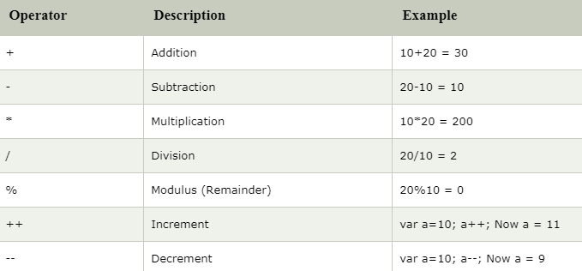
Arithmetic Operators

Slide 4
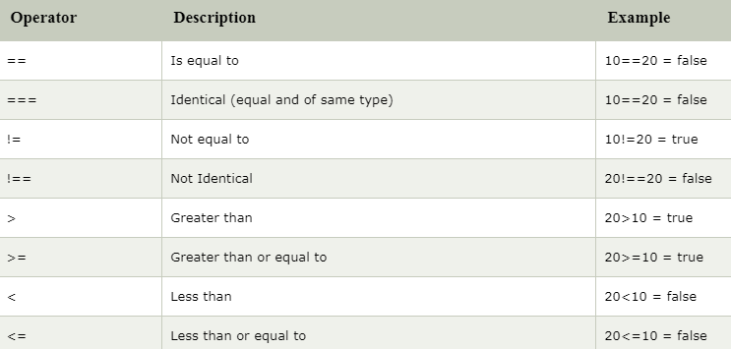
Comparison Operators

Slide 5
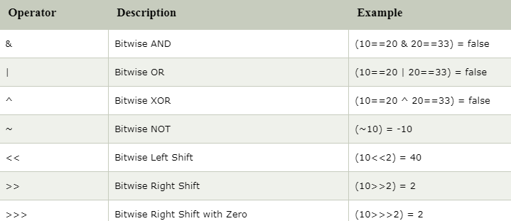
Bitwise Operators

Slide 6
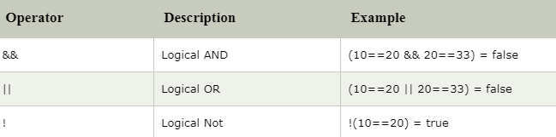
Logical Operators

Slide 7
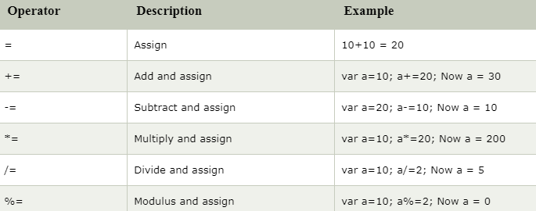
Assignment Operators

Slide 8
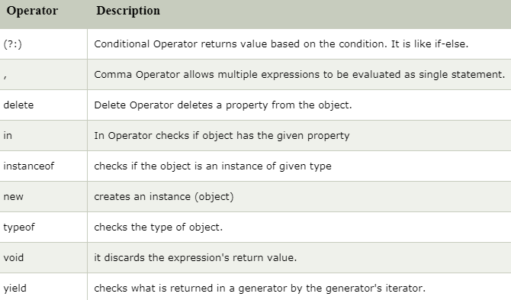
Special Operators

